Slide 1
True sons of the house must be led by the Spirit of the House
Romans 8:12-17
Tuning to God’s frequency
09/10/16

Slide 2
Why “sons”?
God initiated the adoption as sons (Eph 1)
He wants us to receive the best (v5)
He celebrates and lavishes us (v8)
He prepares the future for us (v9)

Slide 3
Why “sons”?
2) Jesus died so that we can be sons
(Gal 4:4-7)
But when the fullness of the time had come, God sent forth His Son, born of a woman, born under the law, to redeem those who were under the law, that we might receive the adoption as sons. And because you are sons, God has sent forth the Spirit of His Son into your hearts, crying out, “Abba, Father!” Therefore you are no longer a slave but a son, and if a son, then an heir of God through Christ.

Slide 4
Why “sons”?
3) The Spirit leads us to be sons
(Rom 8:14-17)
For as many as are led by the Spirit of God, these are sons of God. For you did not receive the spirit of bondage again to fear, but you received the Spirit of adoption by whom we cry out, “Abba, Father.” The Spirit Himself bears witness with our spirit that we are children of God, and if children, then heirs—heirs of God and joint heirs with Christ, if indeed we suffer with Him, that we may also be glorified together.

Slide 5

What is frequency?
Sound with specific wavelength
Spiritual frequency
  Voices
  Thoughts
  Desires
  Heb 1 - God, who at various times and in various ways spoke in time past to the fathers by the prophets, has in these last days spoken to us by His Son, whom He has appointed heir of all things, through whom also He made the worlds;

Slide 6

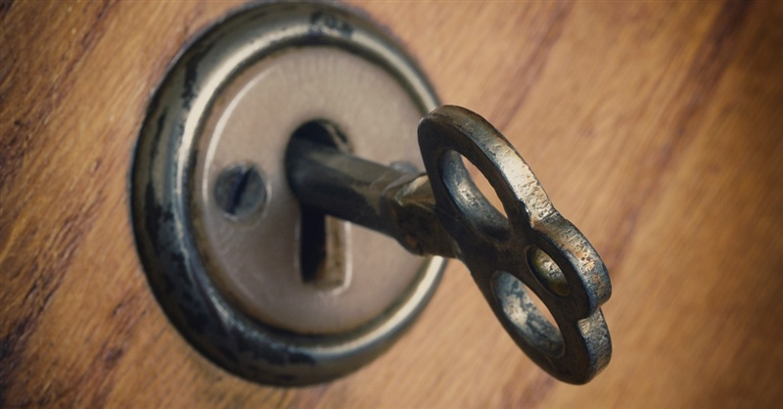
What does frequency do?
1) Creates communication
* Specific channel/bandwidth
- Spirit of God enables us to connect to God
  Prayer (Rom 8:26-28)
  Word (1 Cor 2:10)
  Pathway to Zion

Slide 7
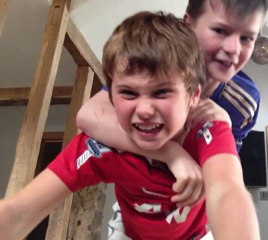
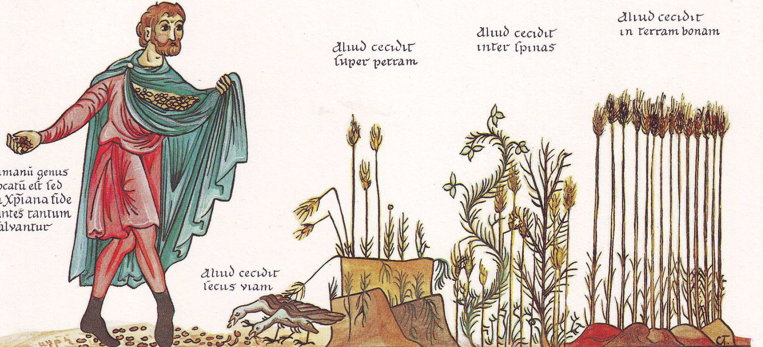
What does frequency do?
  2) Allows impartation (Matt 13)
  * Spiritual things are caught, not just taught
We do not only catch the information, but the spirit, the heart, the feelings of God

Slide 8
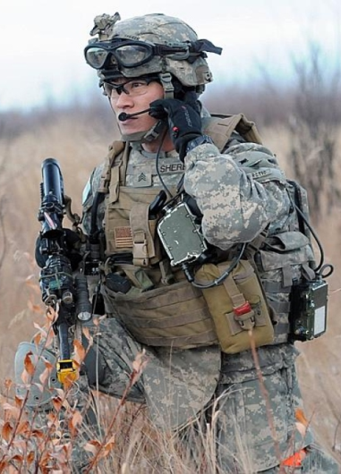
What does frequency do?
3) Creates unity among those who
receive the same frequency
1 Cor 1:10 Now I plead with you, brethren, by the name of our Lord Jesus Christ, that you all speak the same thing, and that there be no divisions among you, but that you be perfectly joined together in the same mind and in the same judgment.
Resonance = amplification
- Lev 28:6, Deut 32:30

Slide 9
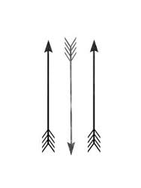
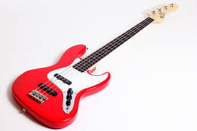
What does frequency do?
4) Access to resources (doors)
- Our frequency must be set (tuned) by the Holy Spirit so that we have access for all that God has planned for our lives.
Resources for the assignment.

Slide 10
Conclusion
Our frequency can be “jammed” by unbelief (e.g. not in prayer).
Guard against other frequencies (the devil, the world, self).
Rom 8:19 - For the earnest expectation of the creation eagerly waits for the revealing of the sons of God
The time to change is NOW!

